Slide 1
FROM SPECIAL MEASURES TO GOOD IN 18 MONTHS
Sport a Vehicle for Change
Case Study: West Heath Primary School
October 2015
The primary school sports funding is used well, and physical education and sport are strengths of the school. Most pupils take part in physical activity or represent one of the many school teams for boys and girls that include rugby, football, netball, basketball, gymnastics, athletics and cross country. Pupils’ physical skills are improving. As a result, an increasing number of teams and individuals are achieving success in inter-school and district competitions. Regular fitness testing and exercise have resulted in almost all pupils’ levels of fitness improving.
OFSTED 2015
The impact of sport:
From special measure to good in only 18 months
Sport inspiring change

Slide 2
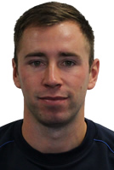
Welcome
Sport has no boundaries. It transcends ethnicity, age, gender and ability. Sport is for all. At West Heath we inspire our pupils to be the best they can be, their dreams and aspirations have no boundaries. With hard work and determination they can achieve whatever they set their minds and hearts too. We have used sport as a vehicle for change.
Sport has changed our pupils’ mind-set, creating a ‘can do’ attitude.
Sport has instilled key values, creating sociable, honest, understanding pupils’.
Sport has raised levels of attainment in physical education and cross curricular as pupils’ are given the opportunity to practically apply the concepts they are learning in the classroom.
Sport has improved behaviour. Pupils strive to achieve to be given the opportunity to represent our school.
West Heath Primary School was a failing school. 18 months ago we were in special measure. We are now a good school with outstanding sport provision. Sport is a major contributing factor to the turn around
and the success of our school. This is how
we maximise our primary school sports
funding .
Content
Background to West Heath Primary School
How we maximise our primary school sports funding
Case Study: The impact of Sport at West Heath
Effective deployment of coaches in schools
Adam Hooper
GetSports-Active Ltd
West Heath Primary School
Future plans moving forward

Slide 3
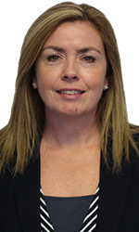
Background to West Heath Primary School
October 2015
Sport
The school is improving rapidly. The head teacher provides an ambitious and well-defined direction for school improvement. She is well supported by senior leaders, an effective staff team and the governing body. Together, they have greatly improved the quality of teaching and pupils’ achievement since the last inspection.
OFSTED 2015
Michelle Hooper
Head Teacher
West Heath Primary School
Pupils that want to come to school and want to learn are key to raising standards. Sport gives them that incentive and instils life long values .

Slide 4
Introduction
How we maximise our primary school sports funding
Introduction
Raising Levels of Attainment
Raising Levels of Attainment
Values Education
Values Education
Competition
Whole School Improvement
Competition
Behavioural Impact
Extra Curricular Support
Physical education is classed as a core subject at West Heath Primary School, It is one of our 4 key curriculum drivers.
Facilities and Equipment
Raising Levels of Attainment
Since her appointment the head teacher has ensured that sports funding has been used to increase participation in sports’ activities. All pupils in Years 2 to 6 now spend at least one lesson each week with qualified coaches, and other activities are provided for younger pupils. The coaches also offer lunchtime and after-school sports activities. It is too early for leaders to have evaluated the impact on pupils’ health, well-being and performance in physical education. OFSTED 2013
The primary school sports funding is used well, and physical education and sport are strengths of the school. Most pupils take part in physical activity or represent one of the many school teams for boys and girls that include rugby, football, netball, basketball, gymnastics, athletics and cross country. Pupils’ physical skills are improving. As a result, an increasing number of teams and individuals are achieving success in inter-school and district competitions. Regular fitness testing and exercise have resulted in almost all pupils’ levels of fitness improving. OFSTED 2015
Level of attainment
Pupils Premium : Non pupils premium
Level of attainment
Extra Curricular : Non Extra Curricular

Slide 5
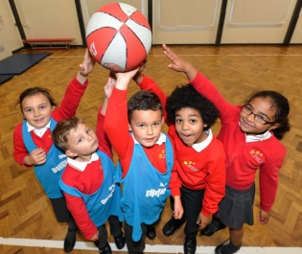
Introduction
How we maximise our primary school sports funding
Introduction
Raising Levels of Attainment
Raising Levels of Attainment
Values Education
Values Education
Competition
Whole School Improvement
Competition
Behavioural Impact
Extra Curricular Support
Society is reflected in sport and sport is a reflection of society. Sport is a fantastic tool create the citizens of tomorrow.
Facilities and Equipment
Values Education
2013
The curriculum is good and provides a rich array of educational experiences. Through the school’s ‘Values Education’, pupils are given frequent opportunities to develop their social, moral, spiritual and cultural awareness, as well as prepare for life in modern Britain. Pupils told inspectors that the ‘Values Education’ programme helps them to be respectful, courteous, tolerant and to celebrate diversity. Pupils have ‘specialist’ teachers for physical education. OFSTED 2015

Slide 6
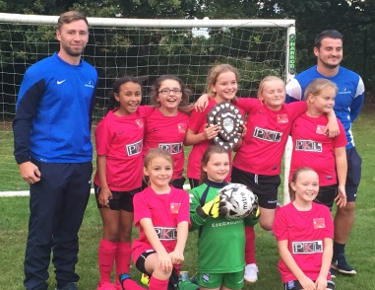
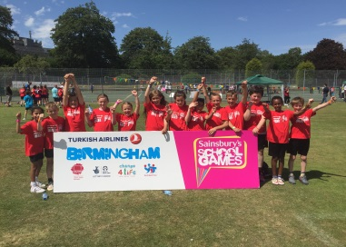
Introduction
How we maximise our primary school sports funding
Introduction
Raising Levels of Attainment
Raising Levels of Attainment
Values Education
Values Education
Competition
Whole School Improvement
Competition
Behavioural Impact
Extra Curricular Support
Life is a competition. A desire to achieve and to do your best is a must. Winning is important.
Facilities and Equipment
Competition
West Heath Primary School have entered many local competitions. We have affiliated to the Kings Norton District school sports program and compete in the Sainsbury's school games working with the School Games Organiser at Colmers Secondary School. Prior to 2014 West Heath Primary School have never been represented at the Sainsbury’s school games. In the last academic year we qualified for the level 3 summer and winter games in gymnastics, handball and tennis. We have multiple teams for a range of sports including Boys Football, Basketball, Netball, Cross-Country, Gymnastics, Girls Football, Rounders, Cricket and Hockey. Competition has brought individual and team success. Moving forward into 2015 – 2016 some pupils have been talent ID with 3 pupils now competing for the district in girls football, 1 pupil now competes at county cricket level, another is playing for Birmingham City Ladies, and a pupils has recently finished 3rd in European tiquando competition.

Slide 7
Introduction
How we maximise our primary school sports funding
Introduction
Raising Levels of Attainment
Raising Levels of Attainment
Values Education
Values Education
Competition
Whole School Improvement
Competition
Behavioural Impact
Pupils can use sport to channel their aggression and provides a motivational tool
Extra Curricular Support
Facilities and Equipment
Behavioural Impact
Behaviour is inadequate because, in too many lessons, pupils do not show a positive attitude to their work and, at times, they do not concentrate and become distracted. OFSTED 2013
Pupils are interested in their learning and have positive attitudes which contribute to the good progress they make. Pupils’ behaviour is well managed. Leaders, teachers, teaching assistants, sports coaches and learning mentors are proactive in planning to meet the particular needs of pupils who demonstrate challenging behaviour. OFSTED 2015
Pupils’ behaviour at break and lunchtimes is excellent, as almost all pupils are engaged in the vast array of activities on offer. These include, for example, basketball, tennis, football, dodgeball, library club, music, dance, cinema club, gymnastics and computer club. Many of the staff can often be found taking part with the children. OFSTED 2015

Slide 8
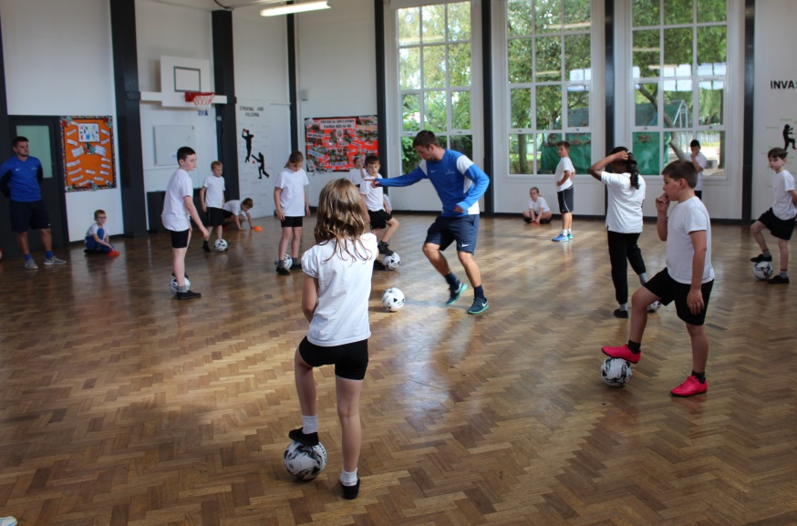
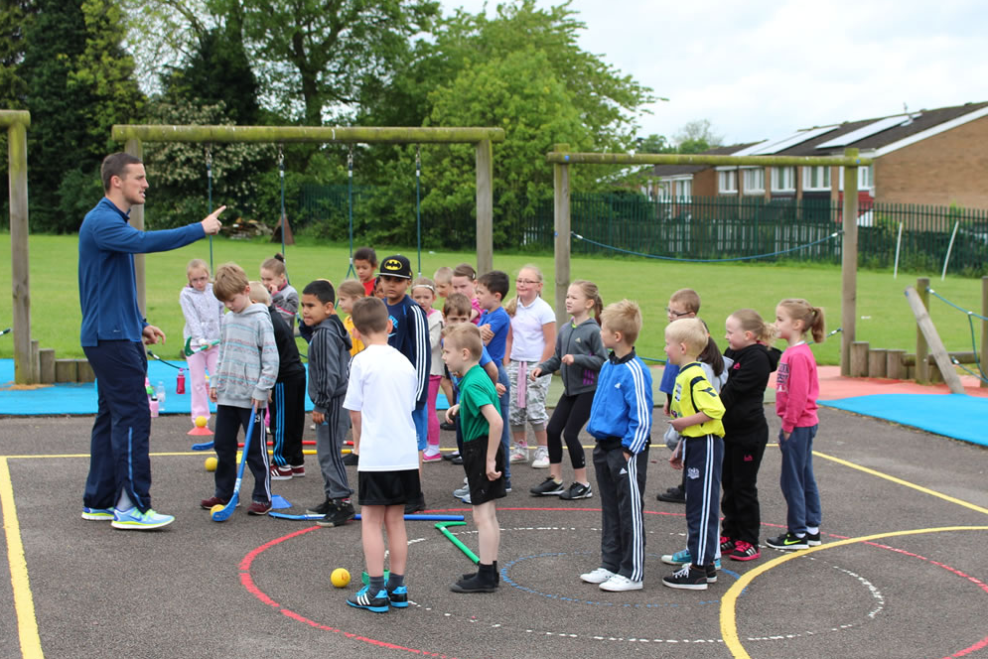
Effective Deployment of Sports Coaches in Schools
Physical Education delivered by specialist in sport and physical education
At West Heath Primary School we have employed specialist in their field to deliver a specialise subject. GetSports-Active Ltd. were founded in 2006. Their managing directors come from high quality sporting backgrounds. Adam Hooper is a former secondary school physical education teacher. He designs and plans lessons knowing the expectation of secondary education and beyond. Colm Tiernan has over 15 years of coaching experience, including experience of coaching abroad. He understands how to engage children and get them enthusiastic about sport. GetSports-Active Ltd. have a trained team of coaches who are proficient in the delivery of a high quality physical education program. They understand the national curriculum and the policies within schools.
GetSports-Active Ltd.
GetSports-Active is an innovative sporting provision. It provides multi sporting opportunities for children, schools and communities with the aim of encouraging healthy lifestyles, lifelong sports participation and social interaction. GetSports-Active looks to provide a positive sporting environment, exposing children, young people and adults to unique experiences and the potential lifelong benefits of sport. Through sport GetSports-Active aspires to stimulate physical growth, raise self-esteem, contribute to social development and enhance overall health and well-being. GetSports-Active reveals the positive impact of sport to children, schools and communities by delivering a range of sports programmes in a manner that is always consistent and of a high quality.

Slide 9
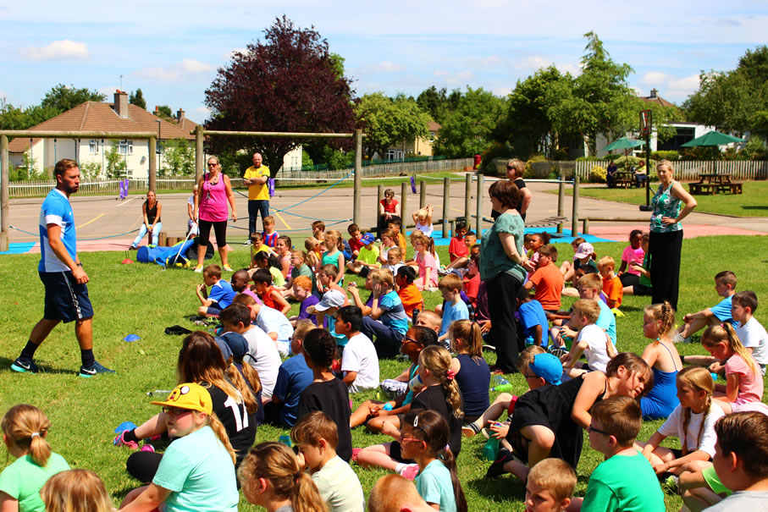
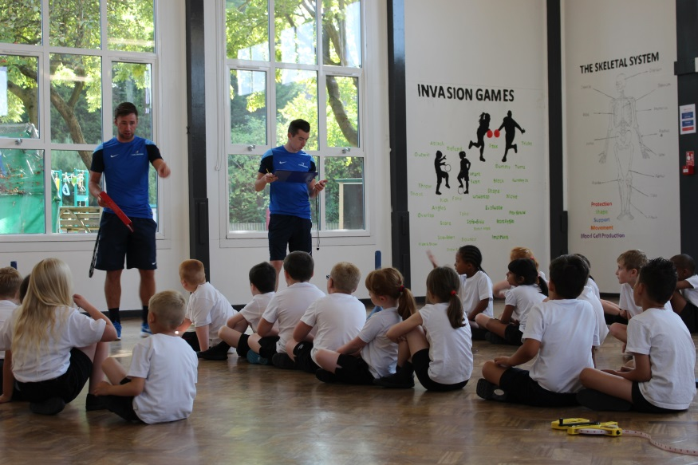
Effective Deployment of Sports Coaches in Schools
Physical Education delivered by specialist in sport and physical education
The GetSports-Active Ltd. product is unique; it offers outstand lessons along side a fantastic assessment profile that measure individual pupil progress and physical fitness. Pupil progress is tracked and has proved valuable as a wider school assessment tool
GetSports-Active Ltd.
The GetSports-Active Ltd. product is unique; it offers outstand lessons along side a fantastic assessment profile that measure individual pupil progress and physical fitness. Pupil progress is tracked and has proved valuable as a wider school assessment tool

